Slide 1

DriverPass System Analysis
David Friend
Notes:
[No speaker notes required for this slide.]

Slide 2

System Requirements
• Functional Requirements:
• The system shall allow customers to create accounts, log in, purchase training packages, schedule driving lessons, and complete practice tests.
• The system shall allow staff to manage schedules, assign instructors and vehicles, update packages, manage users, and run reports.
• Nonfunctional Requirements:
• The system shall be secure, easy to access through a web browser, reliable, and able to support more users as DriverPass grows.
Notes:
. Customers need a simple way to prepare for driving tests and schedule lessons. Staff members need a way to manage lessons, instructors, vehicles, packages, and customer information. The system also needs to be secure and dependable because it will store private customer information and business records.

Slide 3
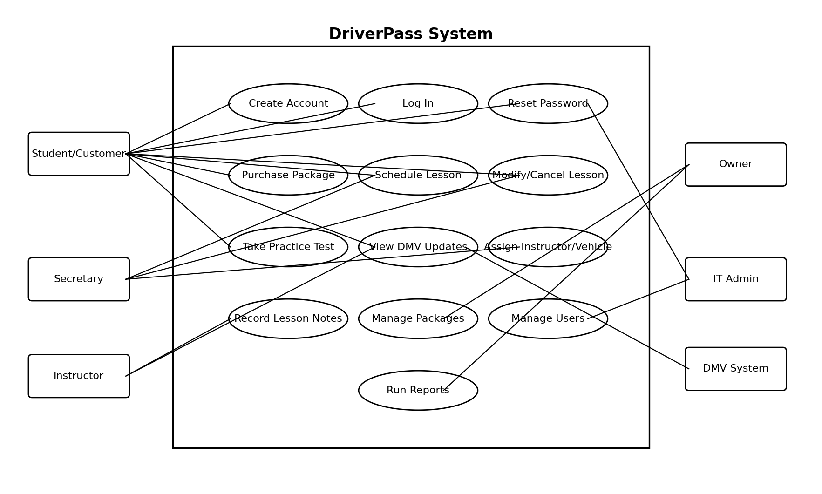
Use Case Diagram
Notes:
This diagram shows the main people who use the DriverPass system and what they need from it. Customers can create accounts, buy packages, schedule lessons, and take practice tests. The secretary can help schedule or change lessons. Instructors can view lesson information and record notes. The owner can review reports and manage packages. The IT administrator manages accounts and system access. This design supports DriverPass by connecting each person to the tasks they need to complete.

Slide 4
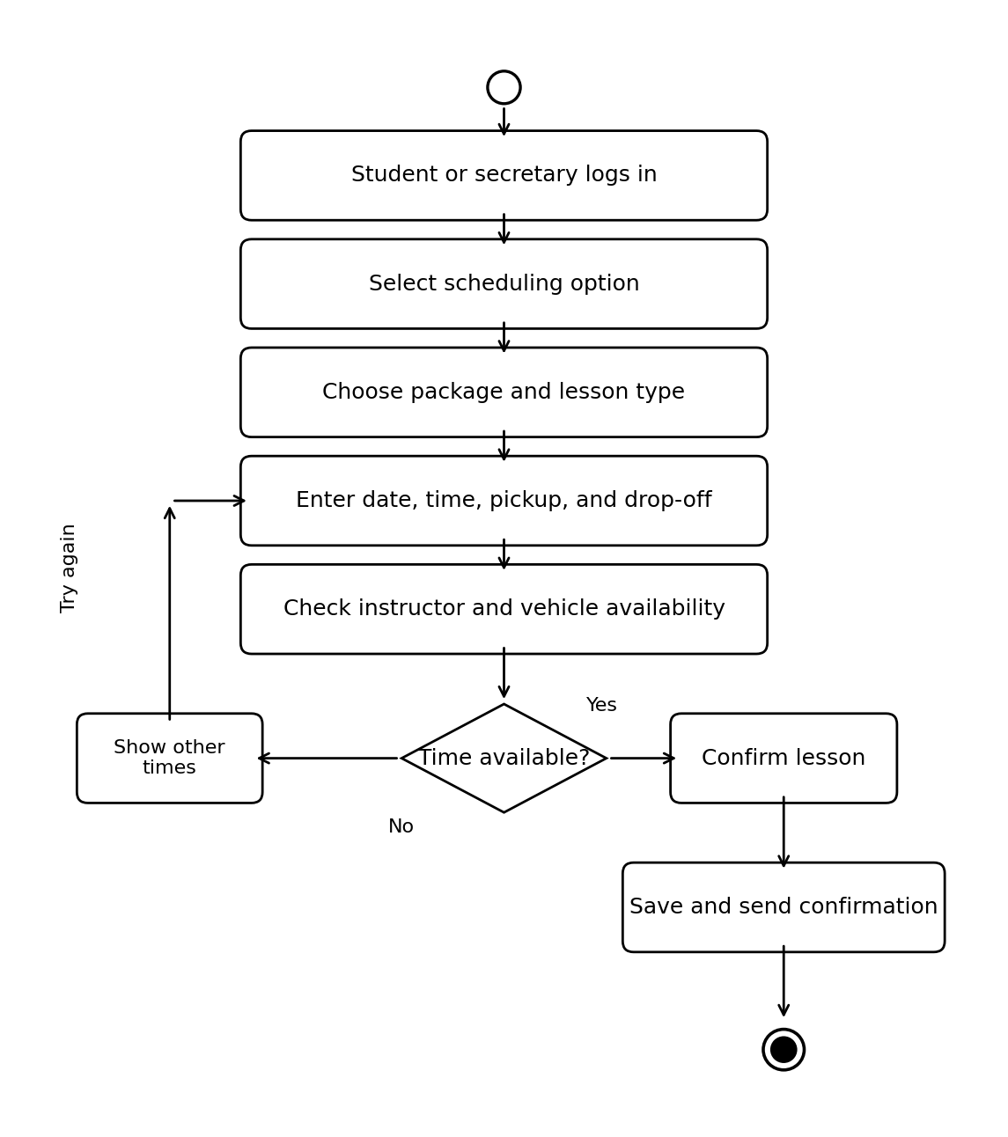
Activity Diagram
[Insert one of your activity diagrams here.]
Notes:
This activity diagram breaks down the process of scheduling a driving lesson. The customer or secretary logs in, chooses the scheduling option, enters the lesson details, and the system checks whether an instructor and vehicle are available. If the time is available, the lesson is confirmed and saved. If it is not available, the system shows other options. This helps DriverPass prevent scheduling conflicts and makes booking lessons easier for customers and staff.

Slide 5
Security
• Users must log in before accessing private information.
• Customer passwords must be protected and not stored as plain text.
• Different users only receive access to the parts of the system they need.
• Accounts should lock or pause after repeated failed login attempts.
• The system should use a secure connection to protect customer data.
Notes:
Security is important because DriverPass will store customer accounts, contact information, schedules, purchases, and testing progress. The design protects this information by requiring users to log in and by limiting access based on each person’s role. For example, customers should not see staff reports, and instructors should only see information related to their lessons. The system should also protect accounts from repeated login attempts and keep information safe while users are connected online.

Slide 6
System Limitations
• The design depends on internet access and a working web browser.
• DMV information must be kept updated by DriverPass or a trusted update process.
• The first version does not include every possible future feature.
• The design may need updates if DriverPass expands to more locations or adds a separate mobile app.
• The system depends on staff entering accurate lesson, package, and vehicle information.
Notes:
This slide explains the limits of the current design. The system is built around web access, so users need internet service and a browser. The system can organize DMV information and practice material, but that information still needs to be kept current. The design covers the main needs for DriverPass now, but future changes may be needed if the business grows, adds new locations, or wants a separate mobile app. These limits are normal for a first system design and can be addressed through future updates.

